Slide 1
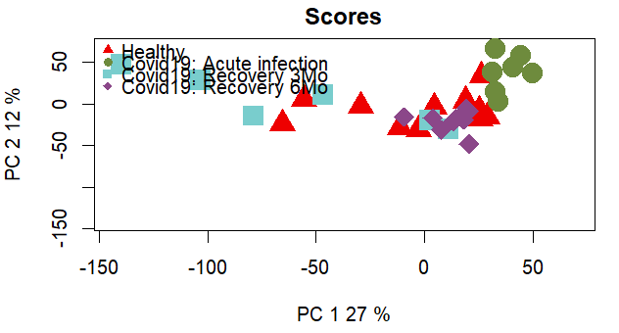
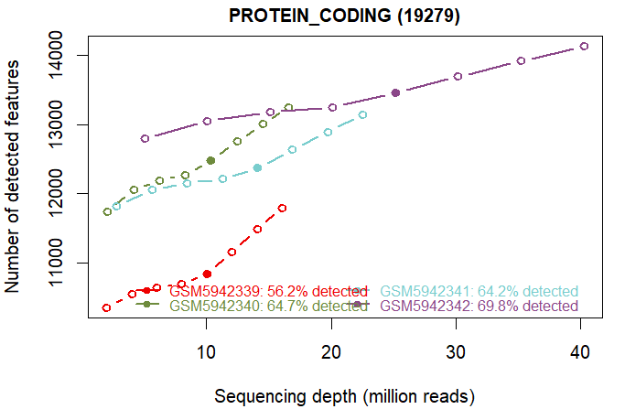
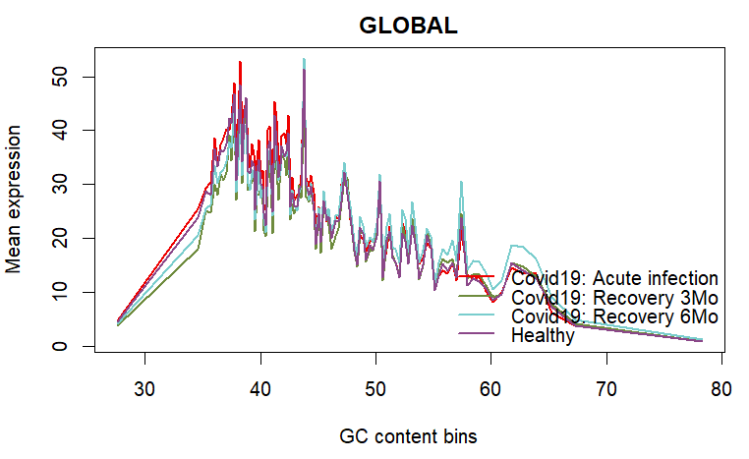
Quality Control (QC):
Prove the data is of good technical quality | Show how the samples group together biologically.
1. Sample Clustering
2. The Saturation Plot (Sequencing Depth)
3. The Bias Plots (Technical Artifacts)
Samples do not form isolated clusters based on their disease state. 'COVID-19 signal' is weak
Curves are beginning to plateau but haven't completely flattened. Normalization needed.
Bias is affecting all samples equally.

Slide 2
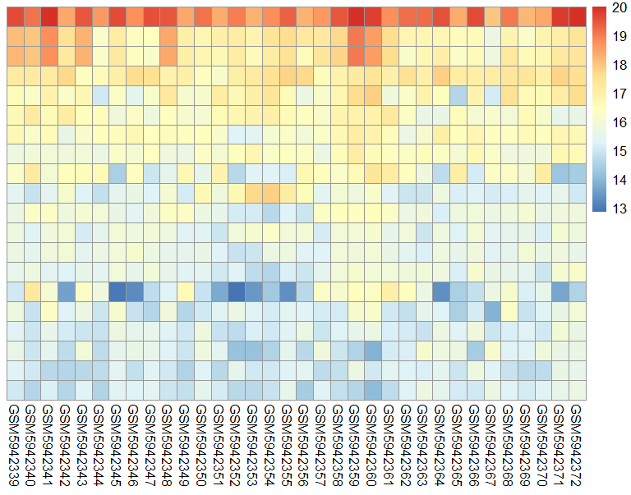
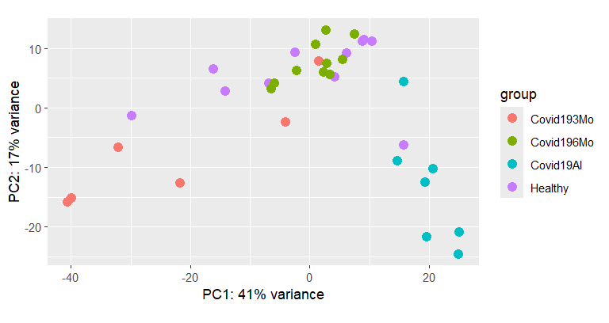
Differential Expression (DESeq2):
Identify significant gene expression changes | Visualize overarching biological patterns
1. The DESeq2 PCA Plot (Sample Clustering)
2. The Heatmap (Top 20 Genes)
PCA reveals a much clearer biological trajectory. We can observe distinct separation between the Healthy baseline cohort and the Acute Infection group along Principal Component 1.
We do not observe uniform blocks of expression segregating purely by disease state among these highly abundant genes.
Not uniform "disease signature”

